Slide 1
Final Project Of Cyber Security
Name: D. Mohan Manohar Reddy
Student ID: 22A91A4411
College: Aditya University

Slide 2
Steganography: Hidden Communication In Plain Sight

Slide 3
Agenda
Introduction to Steganography
Problem Statement
Project Overview
End Users of the Project
Value Proposition
Customization of Project
Modelling
Results
Conclusion
Links

Slide 4
Introduction to Steganography
Definition: Steganography is the art of hiding information within another medium.
Importance: Ensures confidentiality and authenticity in data transmission.
Application: Used in digital watermarking, secure communication, and copyright protection.

Slide 5
Problem Statement
In an age where data breaches and cyber-attacks are increasingly common, ensuring the confidentiality and security of sensitive information has become a critical concern.
Traditional encryption methods, while effective, often signal the presence of sensitive data to potential attackers. This can lead to targeted attacks and efforts to decrypt the data. Steganography, the art of hiding information within non-secret data, offers an additional layer of security by making the presence of the hidden data undetectable to unintended recipients.

Slide 6
Project Overview
Definition: Steganography is the practice of concealing messages or information within other non-secret text or data.
Purpose: To ensure secure communication by hiding data in plain sight within various media formats like images, audio, and video files.
Technologies Used: Python, Tkinter for GUI, Stegano library for image steganography.

Slide 7
End Users of this project
Individuals: Ensuring personal privacy in communication.
Organizations: Protecting sensitive information from competitors and cyber threats.
Government Agencies: Securing confidential communication.
Cybersecurity Professionals: Developing advanced security protocols.

Slide 8
Value Proportion
Enhanced Security:
Hidden Data: Unlike traditional encryption, which makes data unreadable but visible, steganography hides the existence of the data itself within a non-secret medium, making it significantly harder for unauthorized users to detect.
Layered Security: When combined with encryption, steganography provides a double layer of security. Even if the presence of hidden data is suspected, it must still be decrypted.
Versatility and Flexibility:
Multiple Media Formats: Can be applied to a variety of media types including images, audio, video, and text, allowing flexibility in how data is hidden.
Customizable Techniques: Algorithms can be tailored to specific needs, balancing between the amount of data to hide and the quality of the carrier medium.
Cost-Effective Solution:
Minimal Additional Cost: Utilizes existing media without significant additional costs for storage or transmission.
Reduced Risk of Data Breach: Lowers the likelihood of data breaches and the associated financial and reputational costs.

Slide 9
Customization of Project
Algorithm Selection: Choosing appropriate algorithms (e.g., LSB, DCT, DWT) based on the use case.
But, uses the ExifHeader library from the Stegano package. This library typically implements methods
that are not as straightforward as the traditional LSB (Least Significant Bit) method.
Instead, ExifHeader steganography involves embedding data within the metadata (Exif data) of JPEG
images, rather than directly modifying the image pixels.
Media Type: Customizing the project for images, audio, or video based on user requirements.
Here We have used images to hide the secret message. Based on our requirements.
Data Embedding Capacity: Adjusting the amount of data to be hidden without compromising media quality.
Even after we hide the data in an image we cant figure it out the difference between encoded image
and original image.
Security Measures: Implementing additional encryption for enhanced security.
Our project helps the user to hide the data he required to send to the recipient without knowing to the
other person.

Slide 10
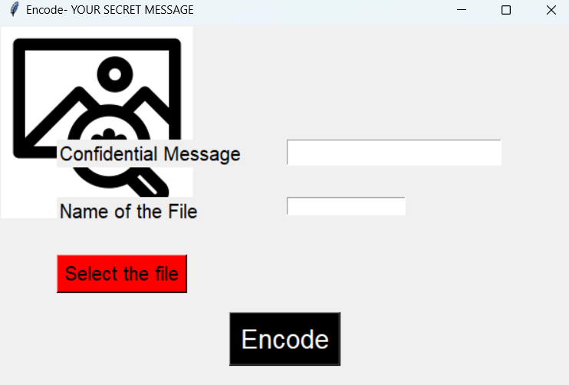
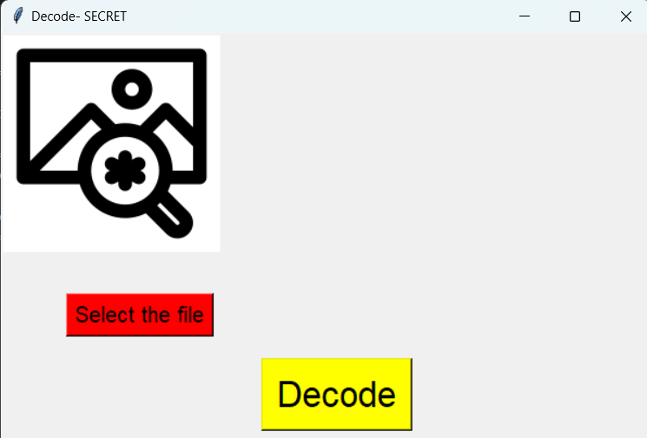
Customization of project (conti…)
In the customization of this project the main coding part as follows:
1.Encoding:
Input the secret message.
Encode the message into the image.
Select an image file.
def Encode():
Screen.destroy()
EncScreen = Tk()
EncScreen.title("Encode- YOUR SECRET MESSAGE")
EncScreen.geometry("600x600+600+600")
EncScreen.config = PhotoImage(file="image url")
label = Label(EncScreen, image=EncScreen.config)
label = Label(text="Confidential Message")
label['font'] = myFont
entry['font'] = myFont
myFont = font.Font(size=15)
label1 = Label(text="Name of the File")
label1['font'] = myFont
SaveEntry = Entry()
2.Decoding:
Select an encoded image file.
Decode the hidden message from the image.
def Decode():
Screen.destroy()
DecScreen = Tk()
DecScreen.title("Decode- SECRET") DecScreen.geometry("600x600+600+600")
DecScreen.config = PhotoImage(file="C:\\Users\\likki\\Downloads\\download.png") label = Label(DecScreen, image= DecScreen.config)
label.place(x=0, y=0)

Slide 11
Modelling
Exif Header Steganography: This method embeds data within the Exif metadata of JPEG images, maintaining high imperceptibility as it does not alter the image pixels but has limited data capacity.
Components of Steganography
Cover Medium: The original file in which the secret data will be hidden. Common cover media include images, audio files, and video files.
2.Secret Message: The data that needs to be hidden. This could be text, another image, an audio clip, or any other type of file.
3.Stego Medium: The cover medium after the secret message has been embedded. It should look or sound like the original cover medium to avoid detection.
4.Steganographic Algorithm: The method used to embed the secret message into the cover medium. Examples include Least Significant Bit (LSB) insertion, Discrete Cosine Transform (DCT), Discrete Wavelet Transform (DWT), and Exif Header steganography.
5.Embedding Process: The process of inserting the secret message into the cover medium using the chosen steganographic algorithm.
6.Extraction Process: The process of retrieving the hidden secret message from the stego medium.

Slide 12
Result
Demonstration: Showing examples of steganography applied to images, audio, or video.
Analysis: Comparing the original and steganographic media to demonstrate the invisibility of hidden data.
Security Assessment: Evaluating the effectiveness of steganographic techniques against detection and extraction attacks.
Conclusions: Summarizing the success of the project and potential improvements.

Slide 13
Links
https://github.com/Mohan-1403/Cyber-Security

